Slide 1
Linear Regression
https://pub.towardsai.net/calculating-simple-linear-regression-and-linear-best-fit-an-in-depth-tutorial-with-math-and-python-804a0cb23660

Slide 2
Introduction
Simplest type of model in machine learning
Statistical approach - Allows us to study and summarize the relationship between two continuous quantitative variables.
Applied in machine learning models, mathematics, statistical modeling, forecasting epidemics, and other quantitative fields.
Two variables
Independent variable (X)
Dependent variable (Y)
Goal is to find out the relationship between independent and dependent variables
Three types of relationships
Deterministic relationship
Random relationship
Statistical relationship

Slide 3
Relationship types
Deterministic relationship - we can predict the output variable using its function
Diameter = 2*pi*radius
Fahrenheit = 1.8*celsius+32
Random relationship - there are no relationships between the variables
Statistical relationship - relationship that is not so perfect, mixture of deterministic and random relationships
Number of chocolates vs. cost
Income vs. expenditure

Slide 4
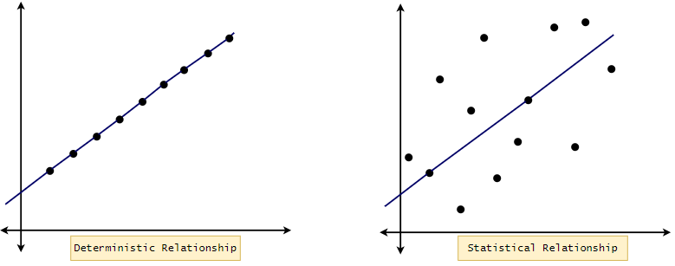
Cont.

Slide 5
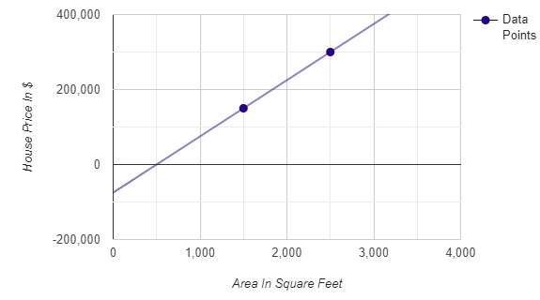
Example
Area | Price
1500 | 150000
1800 | ???
2500 | 300000
Area vs. house price on a scatter plot.

Slide 6
Basics of Coordinate Geometry
We always look from left to right in the coordinate plane to name the points.
After looking from left-to-right, the first point we get must be named (x1,y1), and the second point will be (x2,y2).
Horizontal lines have a slope of 0.
Vertical lines have an “infinite” slope.
If the second point’s Y-coordinate is greater than the Y-coordinate of the first point, then the line has a positive(+) slope. Otherwise, the line has a negative slope.
Points at the same vertical distance from X-axis have the same Y-coordinate.
Points at the same vertical distance from Y-axis have the same X-coordinate.

Slide 7
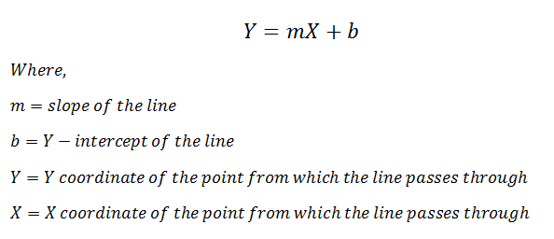
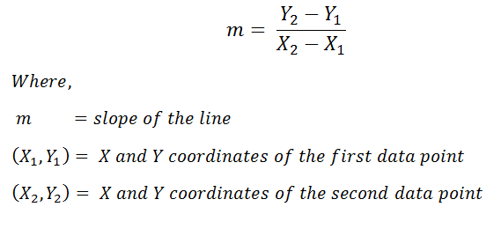
Cont.
We all know that the equation of the line:

Slide 8
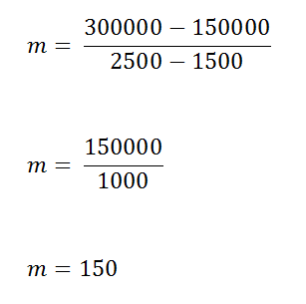
Cont.
From the rules mentioned above, we can infer that in our graph:
(X1 , Y1) = ( 1500 , 150000)
(X2 , Y2) = (2500 , 300000)
Next, we can easily find the slope of the two points.
Taking our example into consideration, in our equation, Y represents the house’s price, and X represents the area of the house.

Slide 9
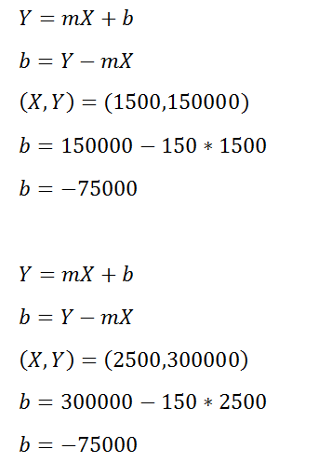
Cont.
Now since we have all the other values, we can calculate the value of intercept b.
Notes:
Notice that we can use any of the points to calculate the slope value. The answer to the slope will always be the same for the same straight line. Next, since we have all our parameters, we can write the equation of line as:

Slide 10

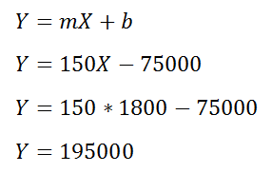
Cont.
Next, since we have all our parameters, we can write the equation of line as:
To find the price of Squidward’s house, we need to plug-in X=1800 in the above equation.
Notes:
should sell his house for $ 195,000.00. That was easy.

Slide 11
Things to Notice
We live in real world
Only two data points are insufficient information
We need a large dataset to generalize or improve our system’s prediction performance
But in a real world environment, with million of data points
Can we find one “single” straight line that “perfectly” fits the whole data?
That’s where the concept of best fit/ regression line comes in.

Slide 12
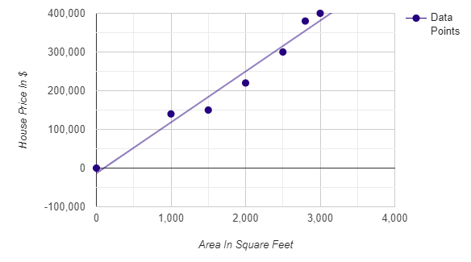
Cont.
Central concept remains the same
Find the equation of the line and plug-in X’s value
(independent variable) to find Y’s value (dependent variable)

Slide 13
Calculating the Linear Best Fit
We cannot plot a single straight line that passes through all the points
Let’s minimize the error
Find a bar and then find the prediction error
We have the actual value here, we can easily find the error in prediction.
Goal will be to find the line that has the minimal error.
That line is called the linear best fit.

Slide 14
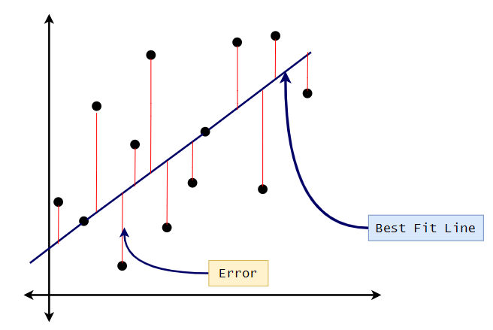
Example

Slide 15
Sum of Squared error
Actual selling price of a house with an area of 1800 square feet is $220,000
Predict the house price (Y = 150X-75000 = 195,000)
Here, there is a prediction error
To represent, we can se the Sum of Squared error calculation technique to find the error in prediction for each of the data points.
We randomly choose the parameters of our line and then calculate the error.
Afterward, we will adjust the parameter again and then calculate the error.
Repeat this until we get the minimum possible error
This process is a part of the gradient descent algorithm

Slide 16
Error
Positive error:
Negative error:
Actual selling price: $ 220,000
Predicted selling price: $ 195,000
Error in prediction: $ 220,000–$ 195,000 = $25,000
Actual selling price: $ 160,000
Predicted selling price: $ 195,000
Error in prediction: $160,000 — $195,000 = -$35,000

Slide 17


Cont.
It is also possible to get a negative error. To account for negative errors, we square the error.
To account for the negative values, we will square the errors.

Slide 18
Guidelines for regression line
Use regression lines when there is a significant correlation to predict values.
Stay within the range of the data, and make sure not to extrapolate. For example, if the data is from 10 to 60, do not try to predict a value for 500.
Do not make predictions for a population that base on another population’s regression line.

Slide 19
Classical Example Problems
Height and weight.
Vital lung capacity and pack-years of smoking.
The driving speed and gas mileage.

Slide 20
Best fit line issues
Issue in the used approach: Although can find the best fit line for a specific dataset but for a larger dataset, this task can be cumbersome
Proposed solution: use a formula that will give us the required parameter values.
Roadmap: Derivation of the formula followed by its implementation
Notes:
In conclusion, a simple linear regression is a technique in which we find a line that best fits our dataset, and once we have that line, we can predict the value of the dependent variable based on the value of the independent variable using the equation of a line and its optimal parameters.

Slide 22


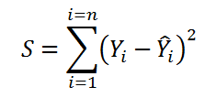
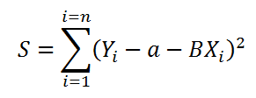
Derivation of Simple Linear Regression Formula:
We have a total of n data points (X, Y), ranging from i=1 to i=n.
2. We define the linear best fit as:
3. We can write the error function as following:
4. We can substitute the value of equation 2 in equation 3:

Slide 23
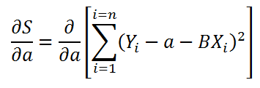
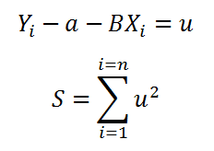

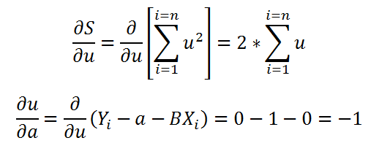
Minimize Error (S)
To minimize S (error function), lets find where the first derivative of S is equal to 0 concerning a and b.
Finding Intercept (a):
Finding the partial derivative of S concerning a:
Simplifying the calculations:
Using chain rule of partial derivations:
Finding partial derivatives:

Slide 24
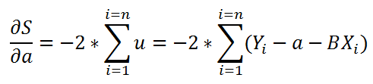
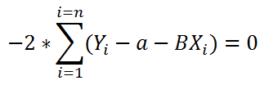
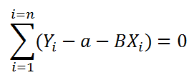
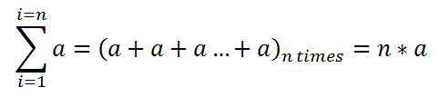
Cont.
Putting it together:
To find the extreme values, we take the derivative=0:
Simplifying:
Further simplifying:

Slide 25
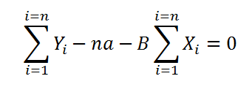

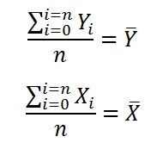

Cont.
Finding the summation of a:
Substituting the values in the main equation:
Simplifying the equation:
Further simplifying the equation:
Simplifying the equation for the value of a:

Slide 26
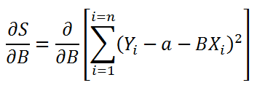
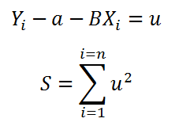

Finding B (Slope)
Finding the partial derivative of S concerning B:
Simplifying the calculations:
Using chain rule of partial derivations:

Slide 27
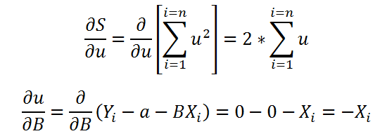
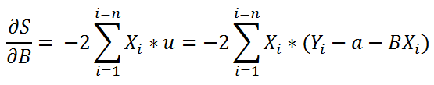

Cont.
Finding partial derivatives:
Putting it together:
Distributing Xi:

Slide 28


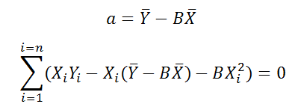
Cont.
To find the extreme values, we take the derivative=0:
Simplifying:
Substituting the value of a in our equation:

Slide 29
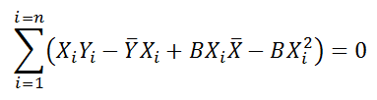

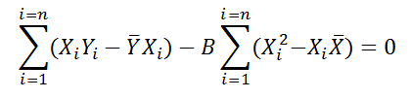
Cont.
Further simplifying:
Splitting up the sum:
Simplifying:

Slide 30

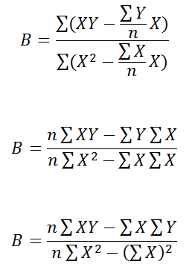
Cont.
Finding B from the above equation:
Further simplifying the equation:

Slide 31
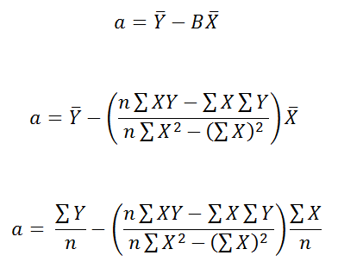
Generalized form for Intercept (a)
Get the value of a (intercept)

Slide 32
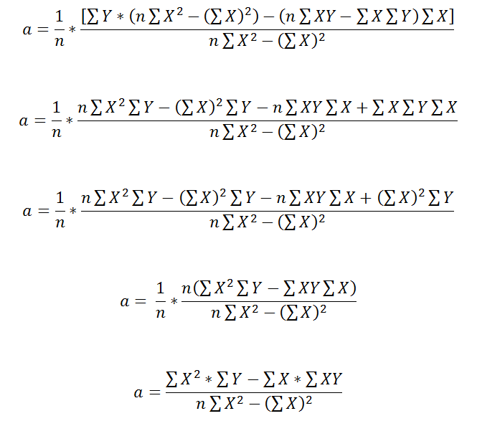
Cont.
Simplify the formula:

Slide 33
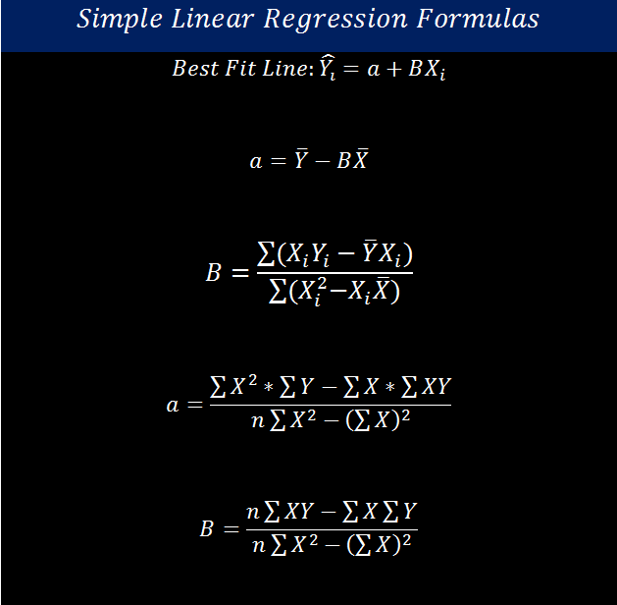
Summary
Notes:
A = [(ΣY)(ΣX²) – (ΣX)(ΣXY)] / [n(ΣX²) – (ΣX)²]
[n(ΣXY) – (ΣX)(ΣY)] / [n(ΣX²) – (ΣX)²]

Slide 34
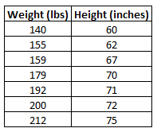
Example – What does that means??

Slide 35
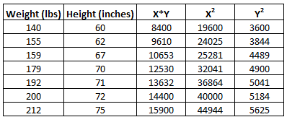
Step 1: Calculate X*Y, X², and Y²

Slide 36
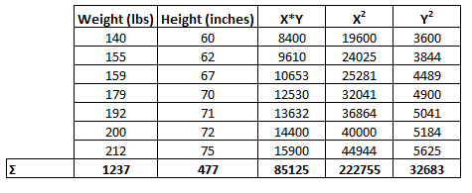
Step 2: Calculate ΣX, ΣY, ΣX*Y, ΣX², and ΣY²

Slide 37
Step 3: Calculate b_{0 (our a)}
The formula to calculate a is: [(ΣY)(ΣX²) – (ΣX)(ΣXY)] / [n(ΣX²) – (ΣX)²]
In this example, a = [(477)(222755) – (1237)(85125)] / [7(222755) – (1237)²] = 32.783

Slide 38
Step 4: Calculate b₁
The formula to calculate b₁ is: [n(ΣXY) – (ΣX)(ΣY)] / [n(ΣX²) – (ΣX)²]
In this example, b₁ = [7(85125) – (1237)(477)] / [7(222755) – (1237)²] = 0.2001

Slide 39
Step 5: Place b₀ and b₁ in the estimated linear regression equation.
The estimated linear regression equation is: ŷ = b₀ + b₁*x
In our example, it is ŷ = 0.32783 + (0.2001)*x

Slide 40
How to Interpret a Simple Linear Regression Equation
Here is how to interpret this estimated linear regression equation: ŷ = 32.783 + 0.2001x
b₀ = 32.7830. When weight is zero pounds, the predicted height is 32.783 inches. Sometimes the value for b₀ can be useful to know, but in this example it doesn’t actually make sense to interpret b₀ since a person can’t weigh zero pounds.
b₁ = 0.2001. A one pound increase in weight is associated with a 0.2001 inch increase in height.

